Slide 1
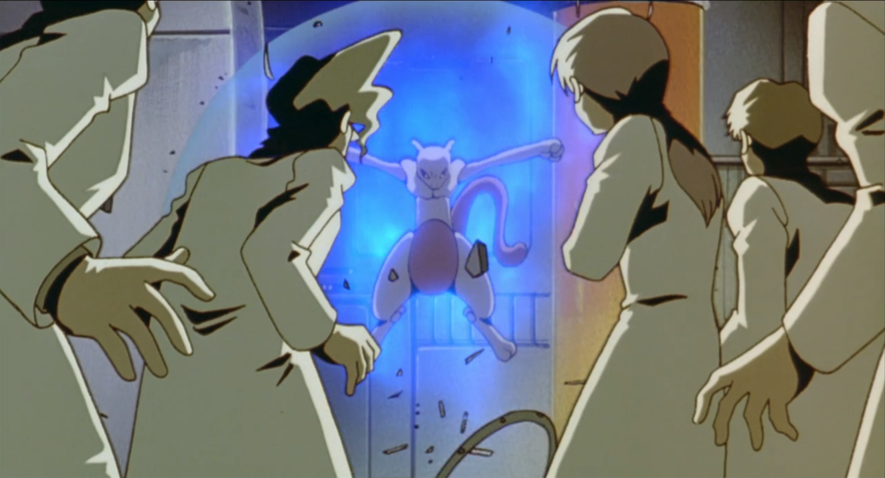
Pokémon dv calculations
Matt Ecker

Slide 2


Goals
Gain a better understanding of API design and development
Study APIs conceptually
Build an API that can calculate Diversification Values for the first generation of Pokémon games (Red, Blue, Green, and Yellow)

Slide 3
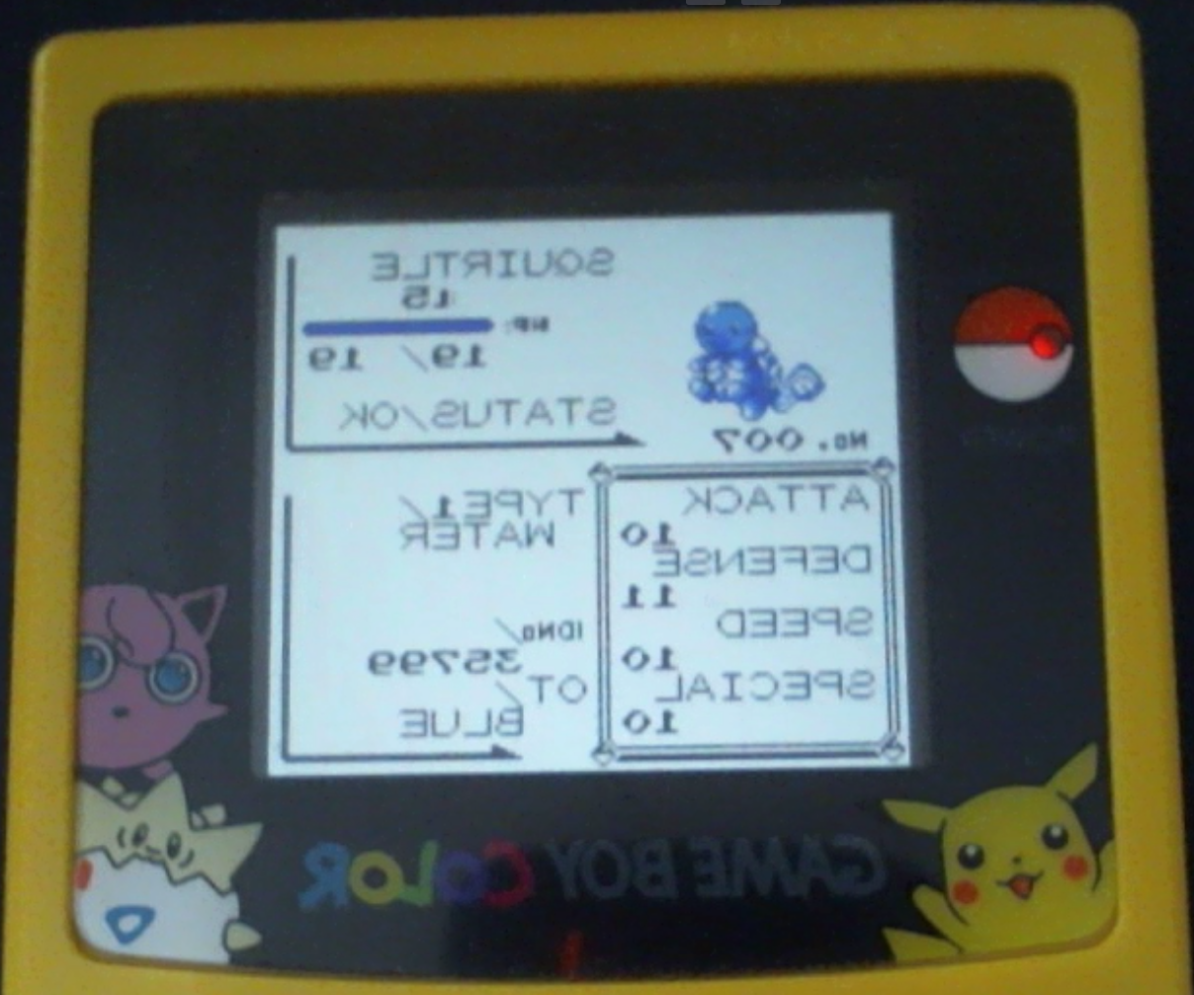
What are Diversification Values?
If you have heard of IVs, DVs are like that but for Gen I & II
DVs are hidden stats that Pokémon are “born” with
These hidden stats are used to calculate what we can see (HP, Attack, Defense, etc.)
In order to find them, we must perform these calculations in reverse, which can be inaccurate

Slide 4

How do we find diversification values?
Understand how stats are calculated
To Summarize
STAT = int(((BaseStat + DV)*2+StatPoint) * Level/100)+E
where E = Level + 10 for HP (E = 5 for any other stat)
StatPoint = int((SQRT(StatExp-1)+1)/4)
StatExp could be its own slide (EVs in later games), essentially there is one for each stat, it starts at 0, and can reach 65,535 (2^16 – 1)
Final equation: STAT = int(((BaseStat + DV)*2+int((SQRT(StatExp-1)+1)/4)) * Level/100) + (hp ? Level + 10 : 5)
Every Pokémon has a hidden “base” for each stat
We can see the “value” of the stat
Using the species (Squirtle), level, base, and value, we can calculate a range for the DV of a Pokémon

Slide 5
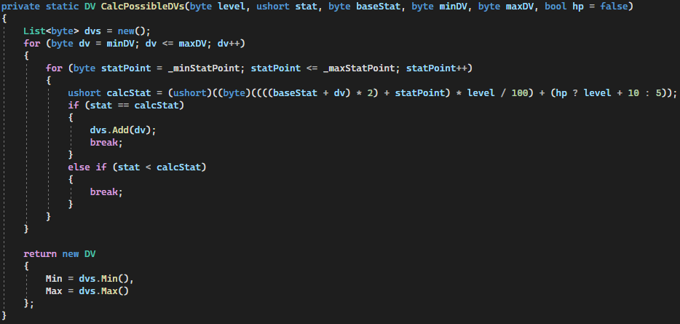
How do we find diversification values?
Find possible DVs
DVs can be anywhere from 0-15 and do not change
Insert everything we know, and the possible values of what we don’t

Slide 6
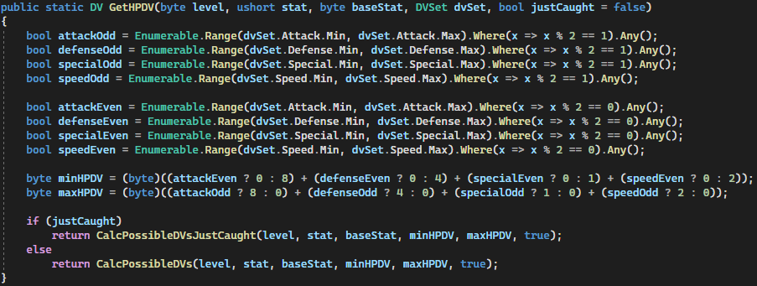
How do we find the hp dv?
Only the DVs for Attack, Defense, Special, and Speed are stored
The last bit of each of these is used to determine the HP DV
An odd Attack DV adds 8, Defense adds 4, Speed adds 2, and Special adds 1

Slide 7
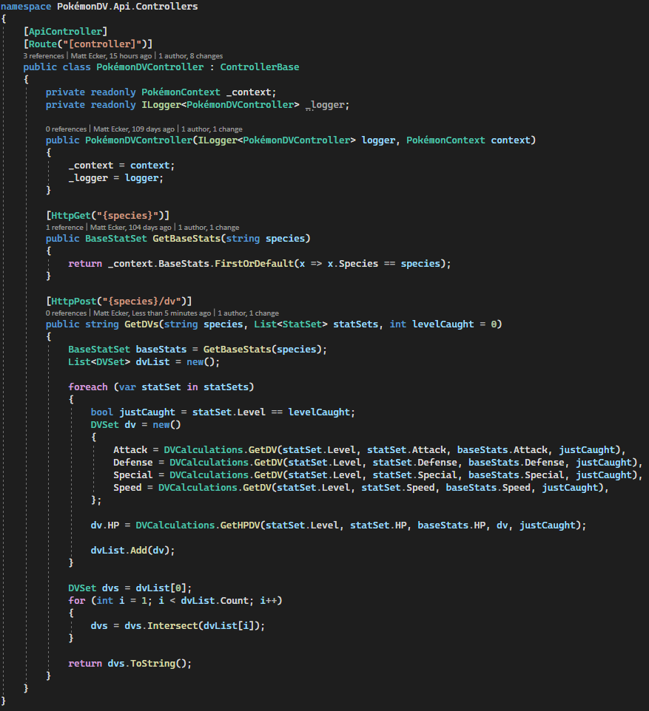
When did I actually build an API?
After I knew what data was needed, I designed the API
GetBaseStats will do what it sounds like; each species of Pokémon has a different base stat for each stat used in DV calculation, which I have stored in a database
GetDVs is also named well, although the input is complex

Slide 8
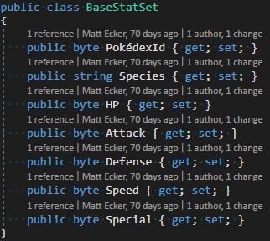
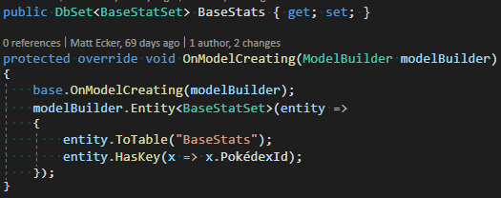
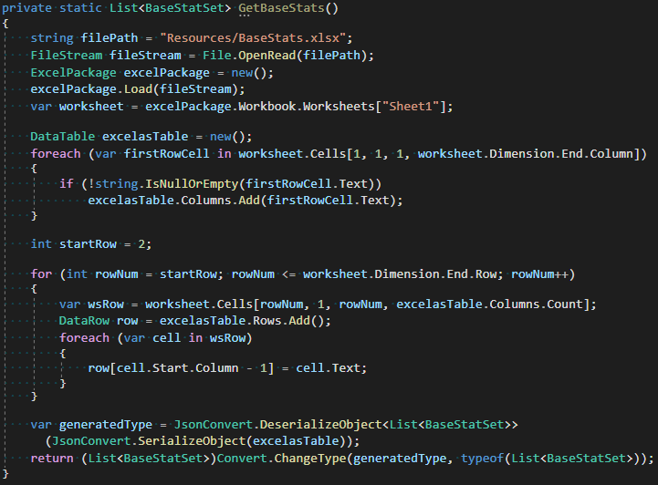
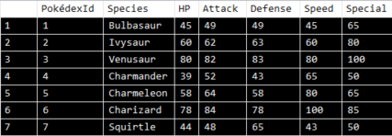
How I stored base stats
Created a model to store each species’ data
Created a DbContext
Wrote a method to create the database for the first time

Slide 9
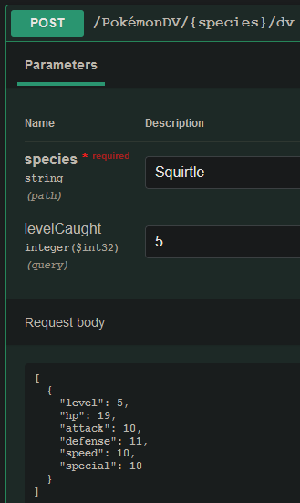
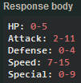
Using getdvs

Slide 10
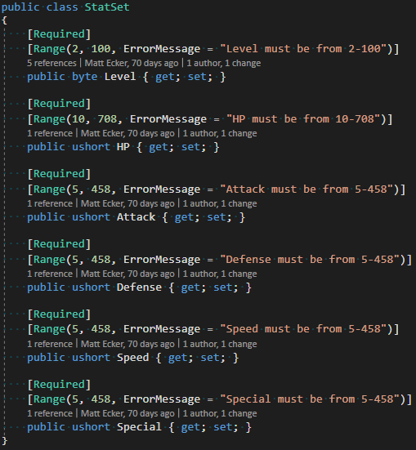
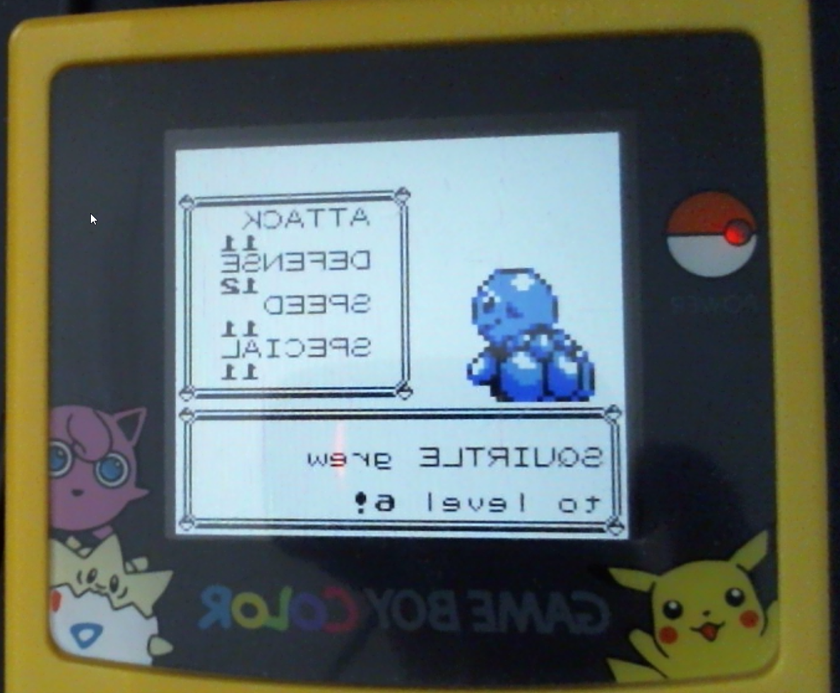
Why does getdvs need a list of statset?
Calculating DVs for a Pokémon with one level of data can be inaccurate
Using multiple levels of data allows us to intersect them and increase accuracy, something that most DV calculators do not allow you to do

Slide 11
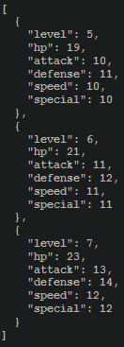
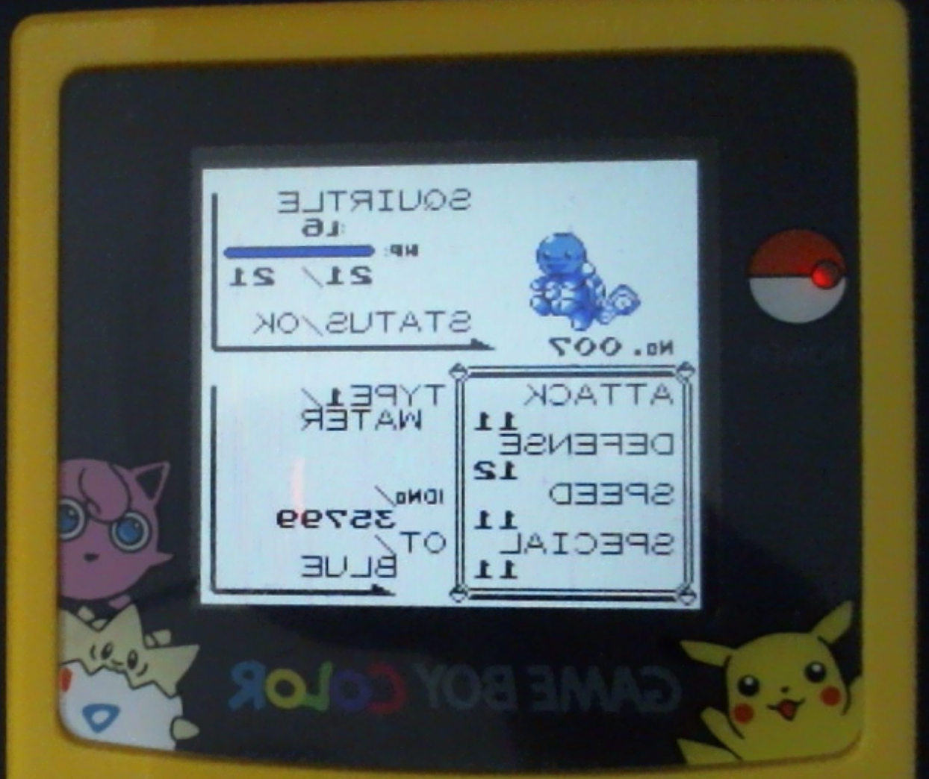
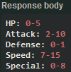
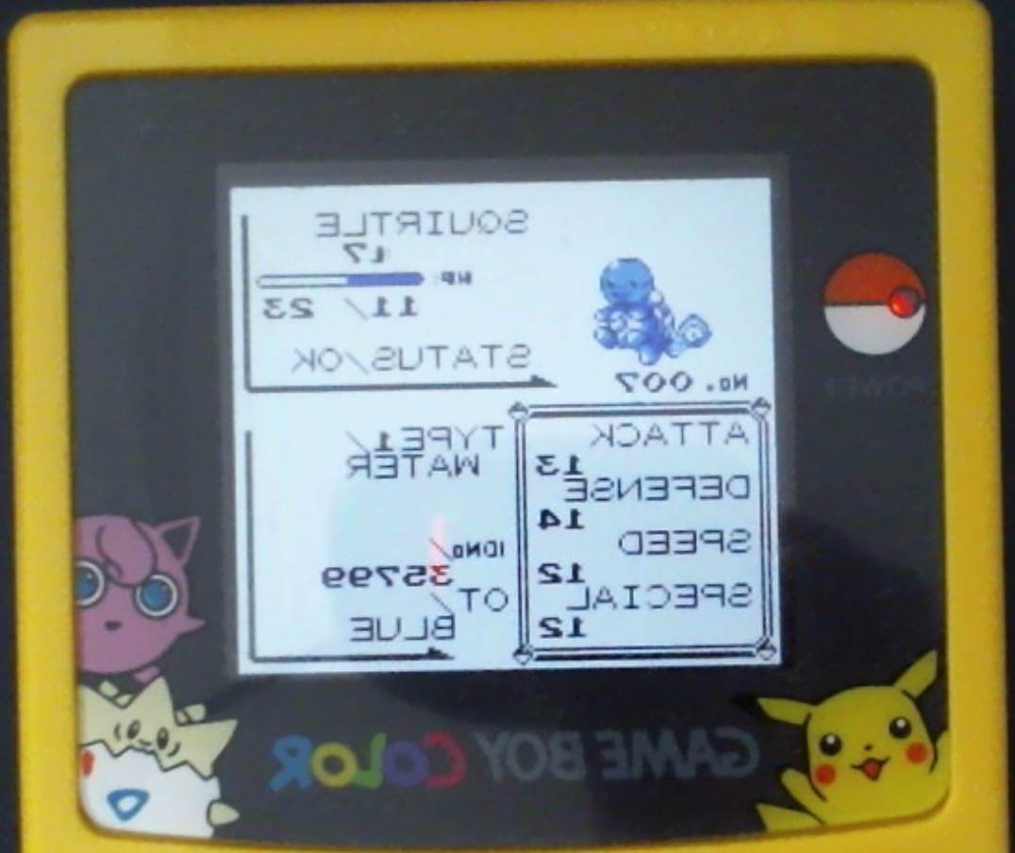
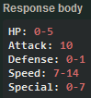
Using getdvs as the very best like no one ever was
5
5 & 6
5, 6, & 7

Slide 12

Lessons Learned

Slide 13
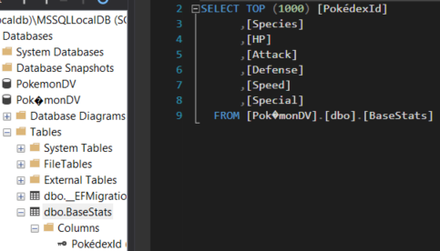
I discovered where I can use é, and where I cannot
I can
I cannot
Solution name
Project name
Class name
Object name
Swagger title
Endpoint URI
Database column
Database name (DbContext fails to read)

Slide 14
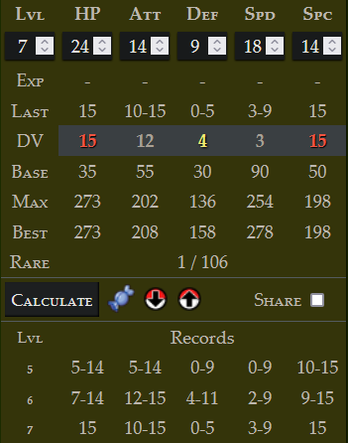
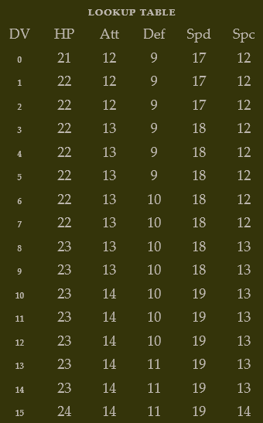
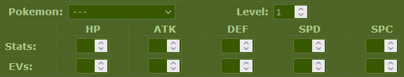
I learned the importance of not using other people’s work as a measure of correctness
Possible stat point values are 0-63
I was running my calculations twice, once with 0 and once with 63, to find the range for a single DV
In excessively rare circumstances, the min stat point calculation could be 15, and the max would be below 0, so it only saves 15 (did not know this was possible)
Every single DV calculator I can find either has this bug or requires you to know the stat point/exp value

Slide 15
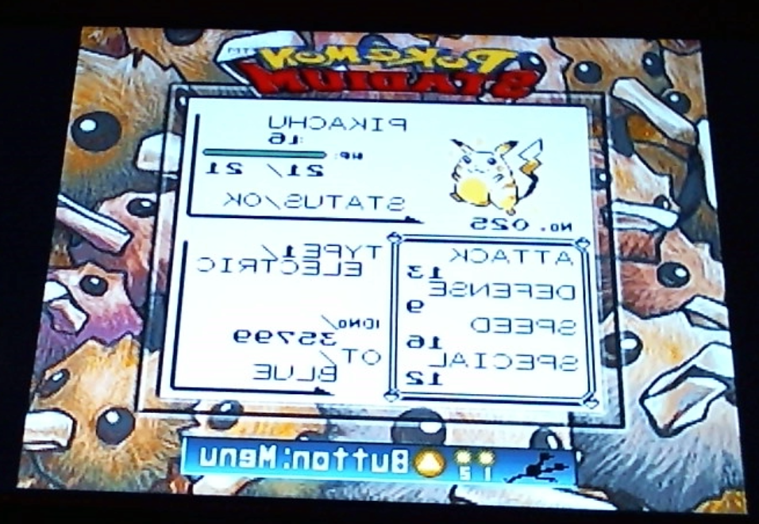
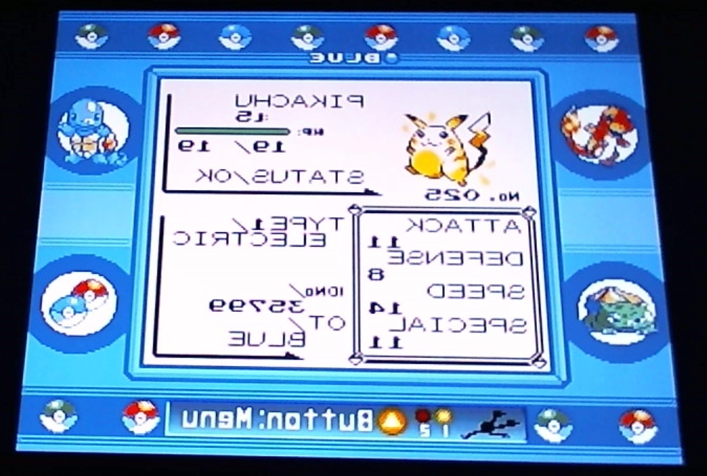
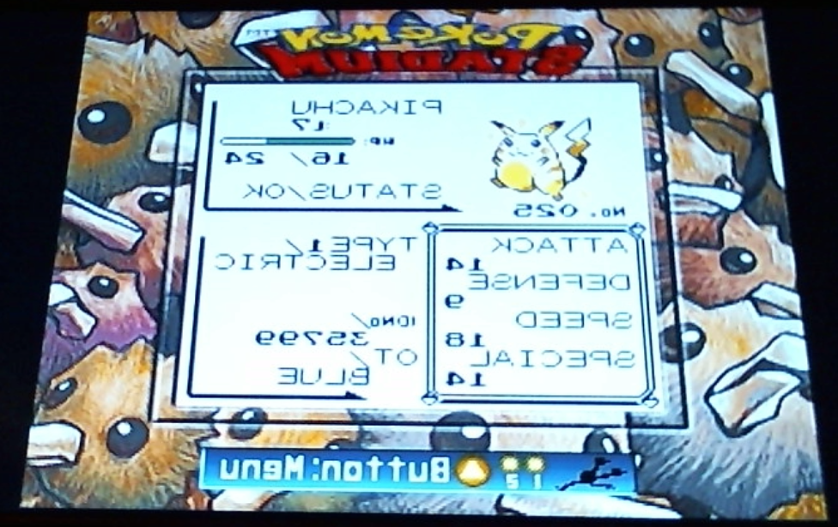
The one in a million pikachu
If any IV was off by 1, it would have changed the HP IV and this bug would not have been exposed
This Pikachu is 1 in 65,536 (not a million I know)

Slide 16

Why am I the only one to solve this issue?
Most DV calculators are lazy, and do not even try to factor in possible stat point values
It is improbable to have a high stat point at level 5
I stole the secret formula from Pokémon Center Mega Tokyo

Slide 17

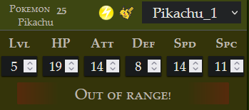
how close to max can we get at level 5?
Exp. All will give Pikachu 3 exp and 56 Attack stat exp per Rattata
Pikachu will end up at 27,280 stat exp, which is a stat point of 41
Pikachu’s attack value will be 14
Pikachu is so juiced he breaks other DV calculators
Catch a Pikachu at level 5
Repeat until you find one that has the same DVs as mine
90% chance of success after 150,901 attempts
Purchase ten Protein (extremely expensive) and use them on Pikachu
Collect 50 Pokémon
Travel to Route 15 and speak to the Aid to receive Exp. All
Using a more powerful Pokémon and a full party of six, run around on Route 1 and defeat 30 level 2 Rattata’s
may need to start with Pikachu then swap out
It is possible to juice him even further using the Pokérus virus, but the chance of contraction is 3 in 65,536

Slide 18

I ignored the advice of linus torvalds
I can’t find it anymore, but Linus Torvalds once said that if you’re using more than three parameters for a method, you’re doing it wrong
Early on in development of Pokémon DV API, I thought that I could reduce the number of methods I needed by accepting more parameters
This resulted in giant methods with half a dozen code paths, making what should have been straightforward overly complex

Slide 19

Plans for the future
Expand to cover Gen II Pokémon
Allow multi-species input with data pre- and post-evolution
Unit tests
In-memory database
Convert repeated mathematical operations into calculus

Slide 20



